Slide 1
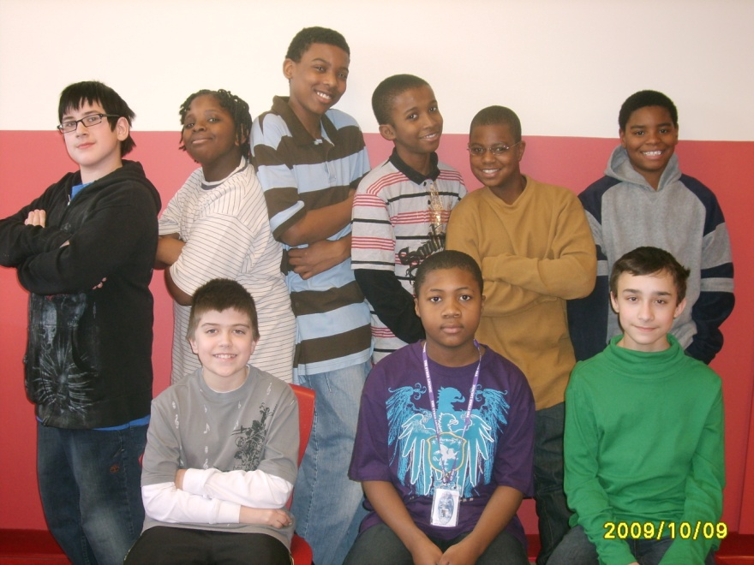
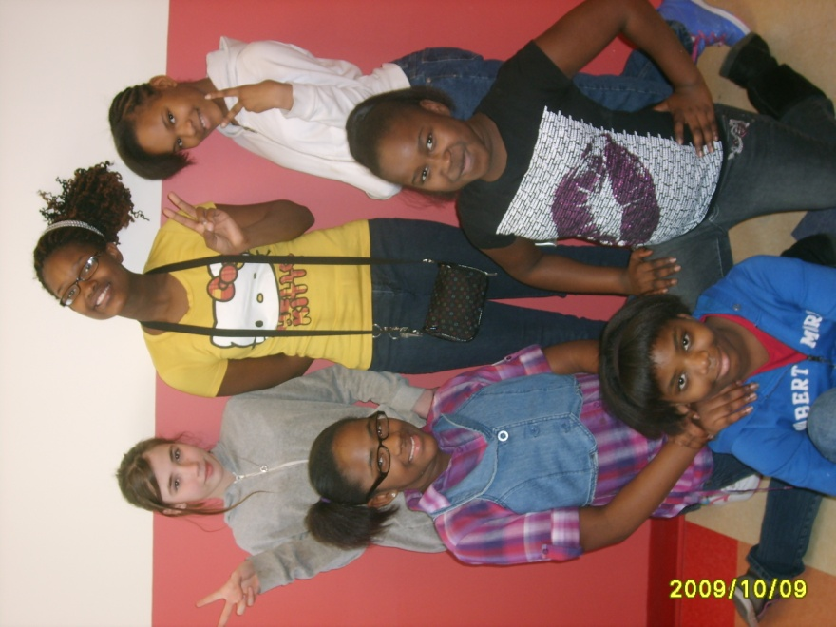
PSSA Test Taking Tips
from Miss Mills
& Mr. Frisk’s
6th grade class
2009-2010

Slide 2
“Use our test taking tips for PSSA success!” encourages Rashaem.

Slide 3
1 Karen recommends, “Get plenty of rest the night before the test.”

Slide 4
2 .
“Eat a healthy breakfast,” adds Laturne.

Slide 5
3
Anauja advises, “Wear comfortable clothing.”

Slide 6
4 “Think positive and do your best,” insists Glenn.
I can score Proficient!

Slide 7
5 “Read carefully,” urges Lanasia. “Look at all directions and questions.”

Slide 8
6 “Be sure to highlight key words in the questions,” instructs Roscoe.

Slide 9
7
“Read every answer choice,” says Gregory. “Eliminate ones you know are wrong.”

Slide 10
8 “Don’t spend all your test time on a question that’s too hard,” cautions Anizeonna. “Mark it and go back to it later.”

Slide 11
9 Dresden exclaims, “Always restate the question as part of your answer!”

Slide 12
10 Justice pleads, “Support your answer with details from the passage!”

Slide 13
11 “Neatness counts,” Christian points out. “Make sure your writing is legible.”
Uh oh, I’d better fix that 4! It almost looks like a 9.

Slide 14
12 “Check your work when you’re finished,” requests DeAsia .

Slide 15
Good Luck!

